Slide 1
CEIS 114
Final Project Deliverables PowerPoint
Name: Fontane Aker
Professor: Shadeeb Hossain
Session: March 2025
Date: April 21, 2025

Slide 2
Final Project Contents Due Saturday of Week 8
Title Slide
Introduction Slide
Transition Slides for every Module as shown below
Module 2 project:
Module 3 project :
Module 4 project :
Module 5 project :
Module 6 project :
Module 7 project :
Challenges
Career Skills
Conclusion
Final project’s Wix link (or personal webpage)
Insert Transition Slides here

Slide 3
Introduction
This course explores foundational electronic, digital, and system integration concepts common in modern computing devices. Digital devices are examined from the electronic component level to a fully integrated system.
In this session we built a Multiple Traffic Light Controller with Cross Walk, Buzzer, and LCD Display with IOT Access

Slide 4
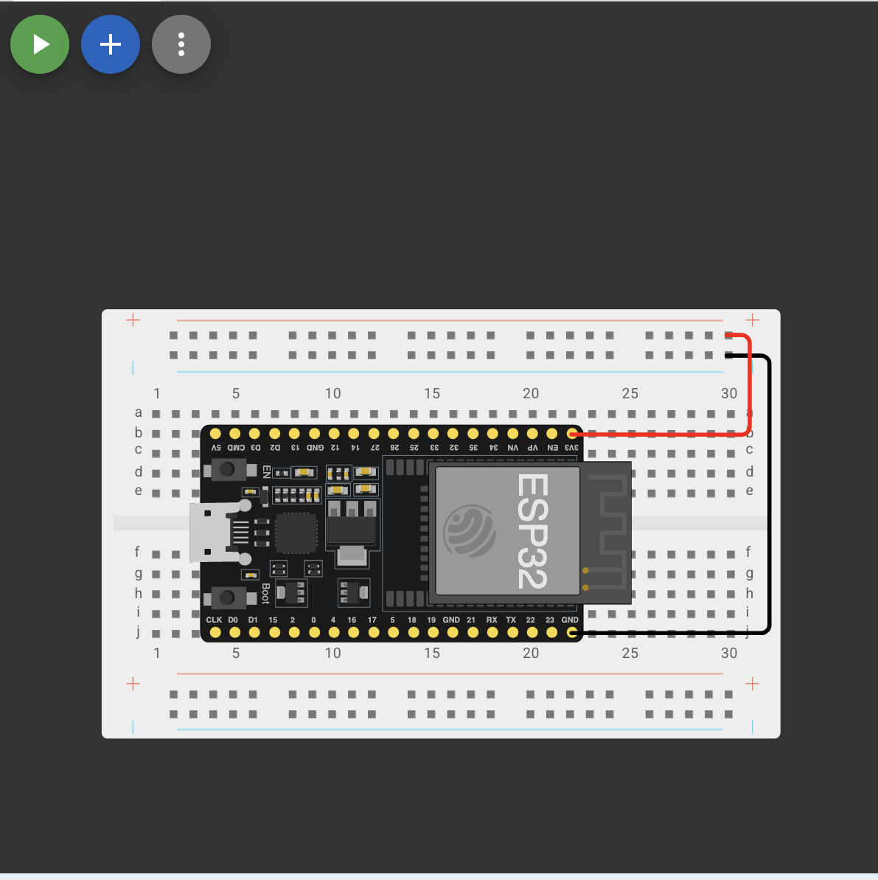
ESP32 (Screenshot)
Microcontroller mounted and powered ON

Slide 5
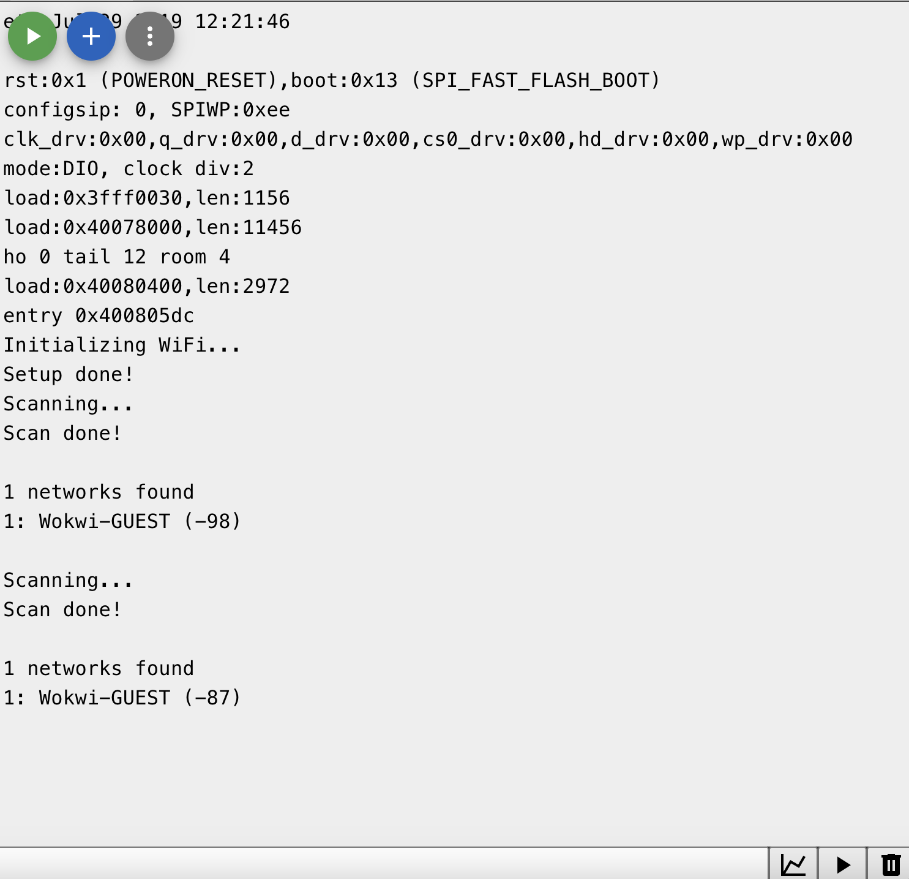
ESP32 WiFi Scan
Screenshot of Serial Monitor showing the available networks

Slide 6
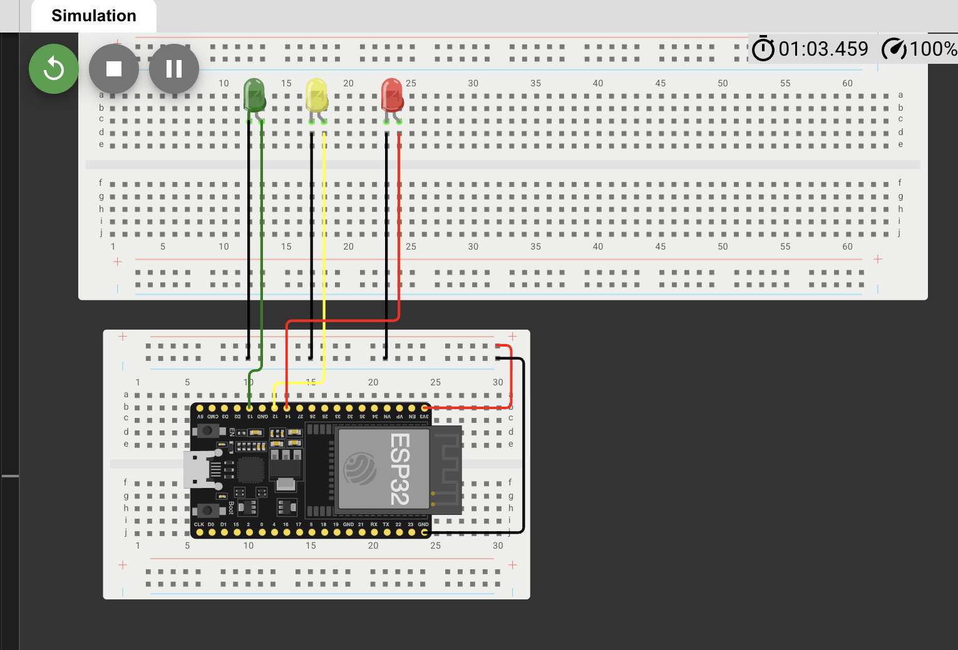
Picture of circuit with working LEDs
ESP 32 Board
Colored LEDs: Red, Yellow and Green
Wires
Breadboard

Slide 7
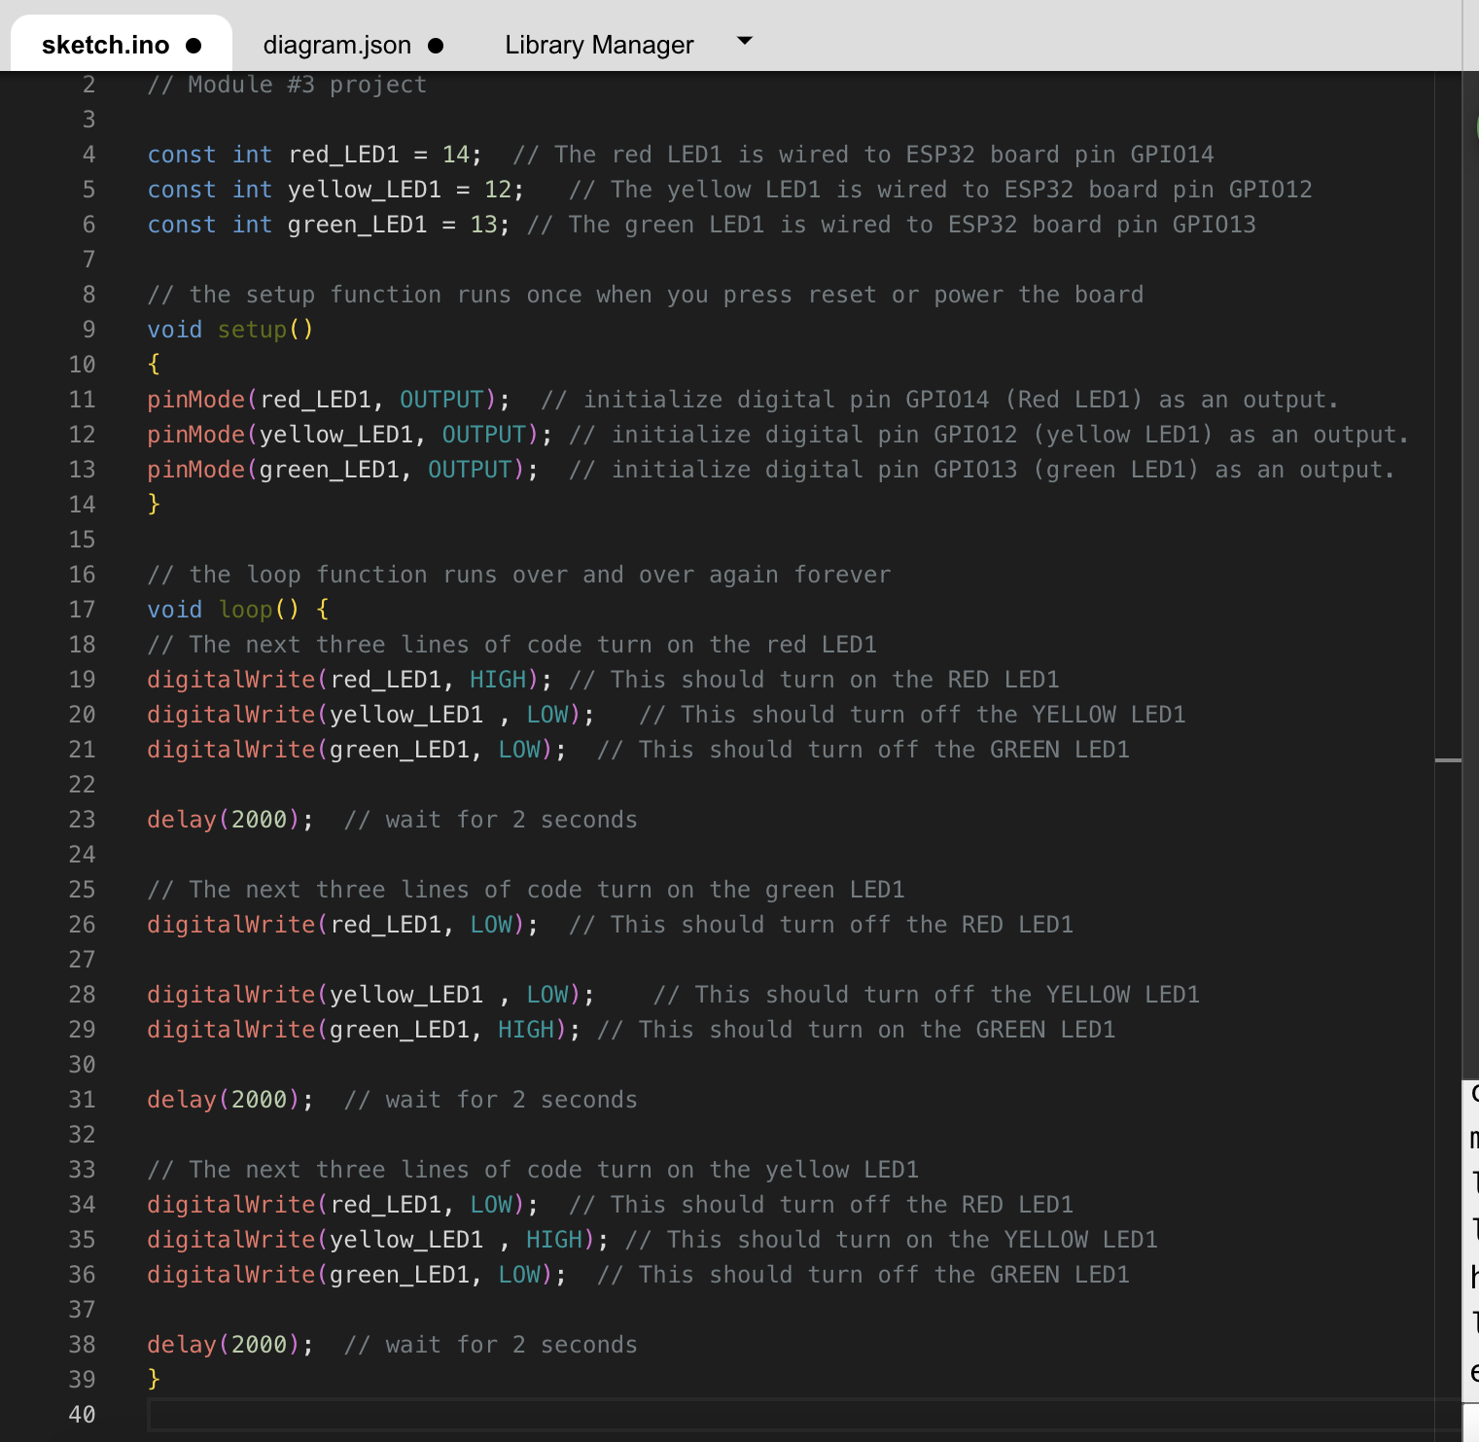
Screenshot of code in the Code Editor
Screenshot of code in the Wokwi Code Editor showing your name in the comment

Slide 8
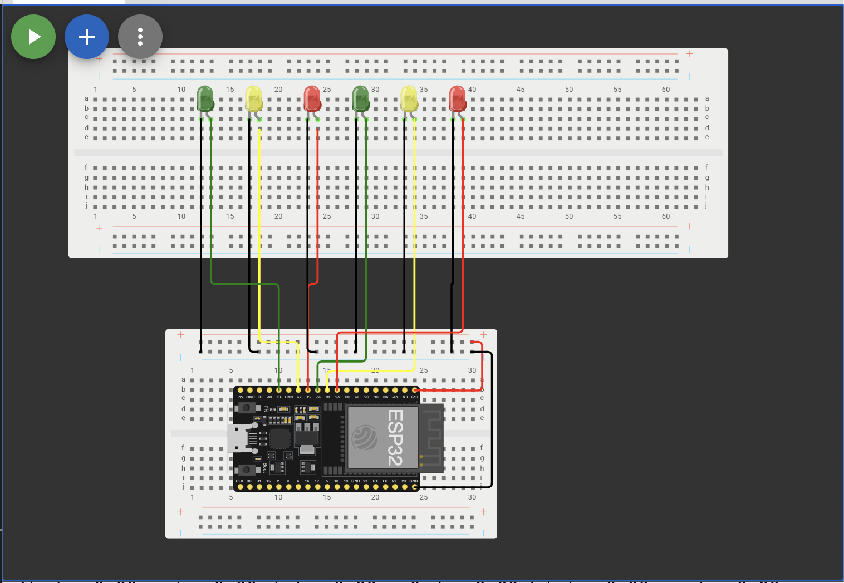
Picture of circuit with working LEDs
ESP 32 Board
Colored LEDs: Red, Yellow and Green (two sets)
Wires
Breadboard

Slide 9
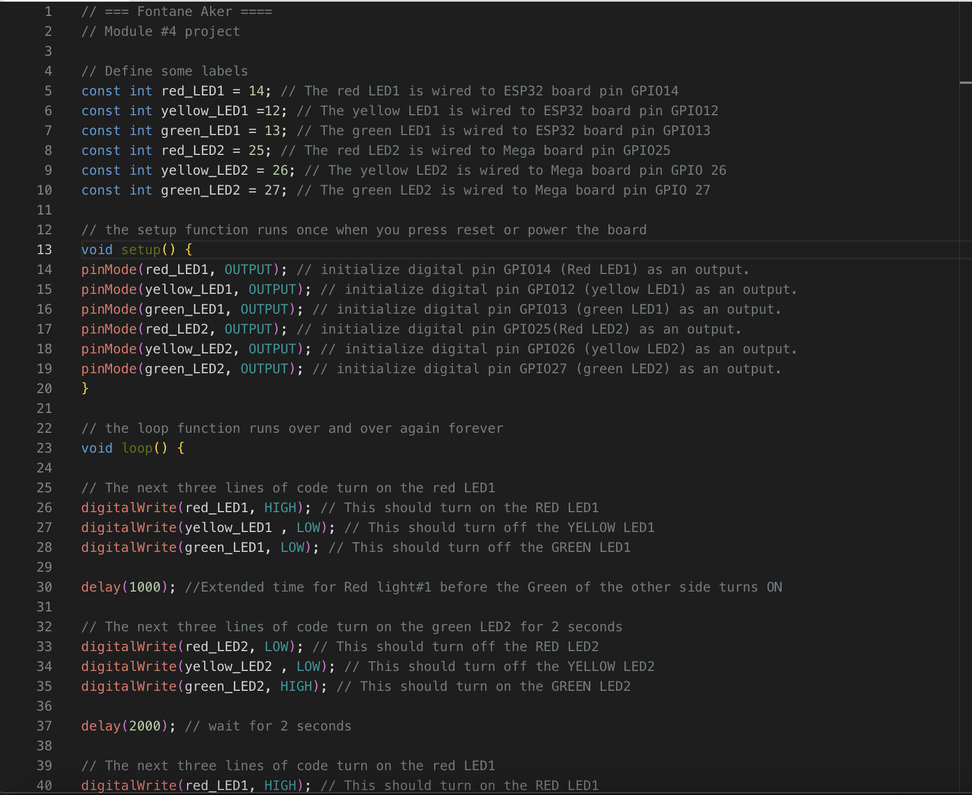
Screenshot of code in Wokwi
Screenshot of code Wokwi Code Editor showing your name in the comment

Slide 10
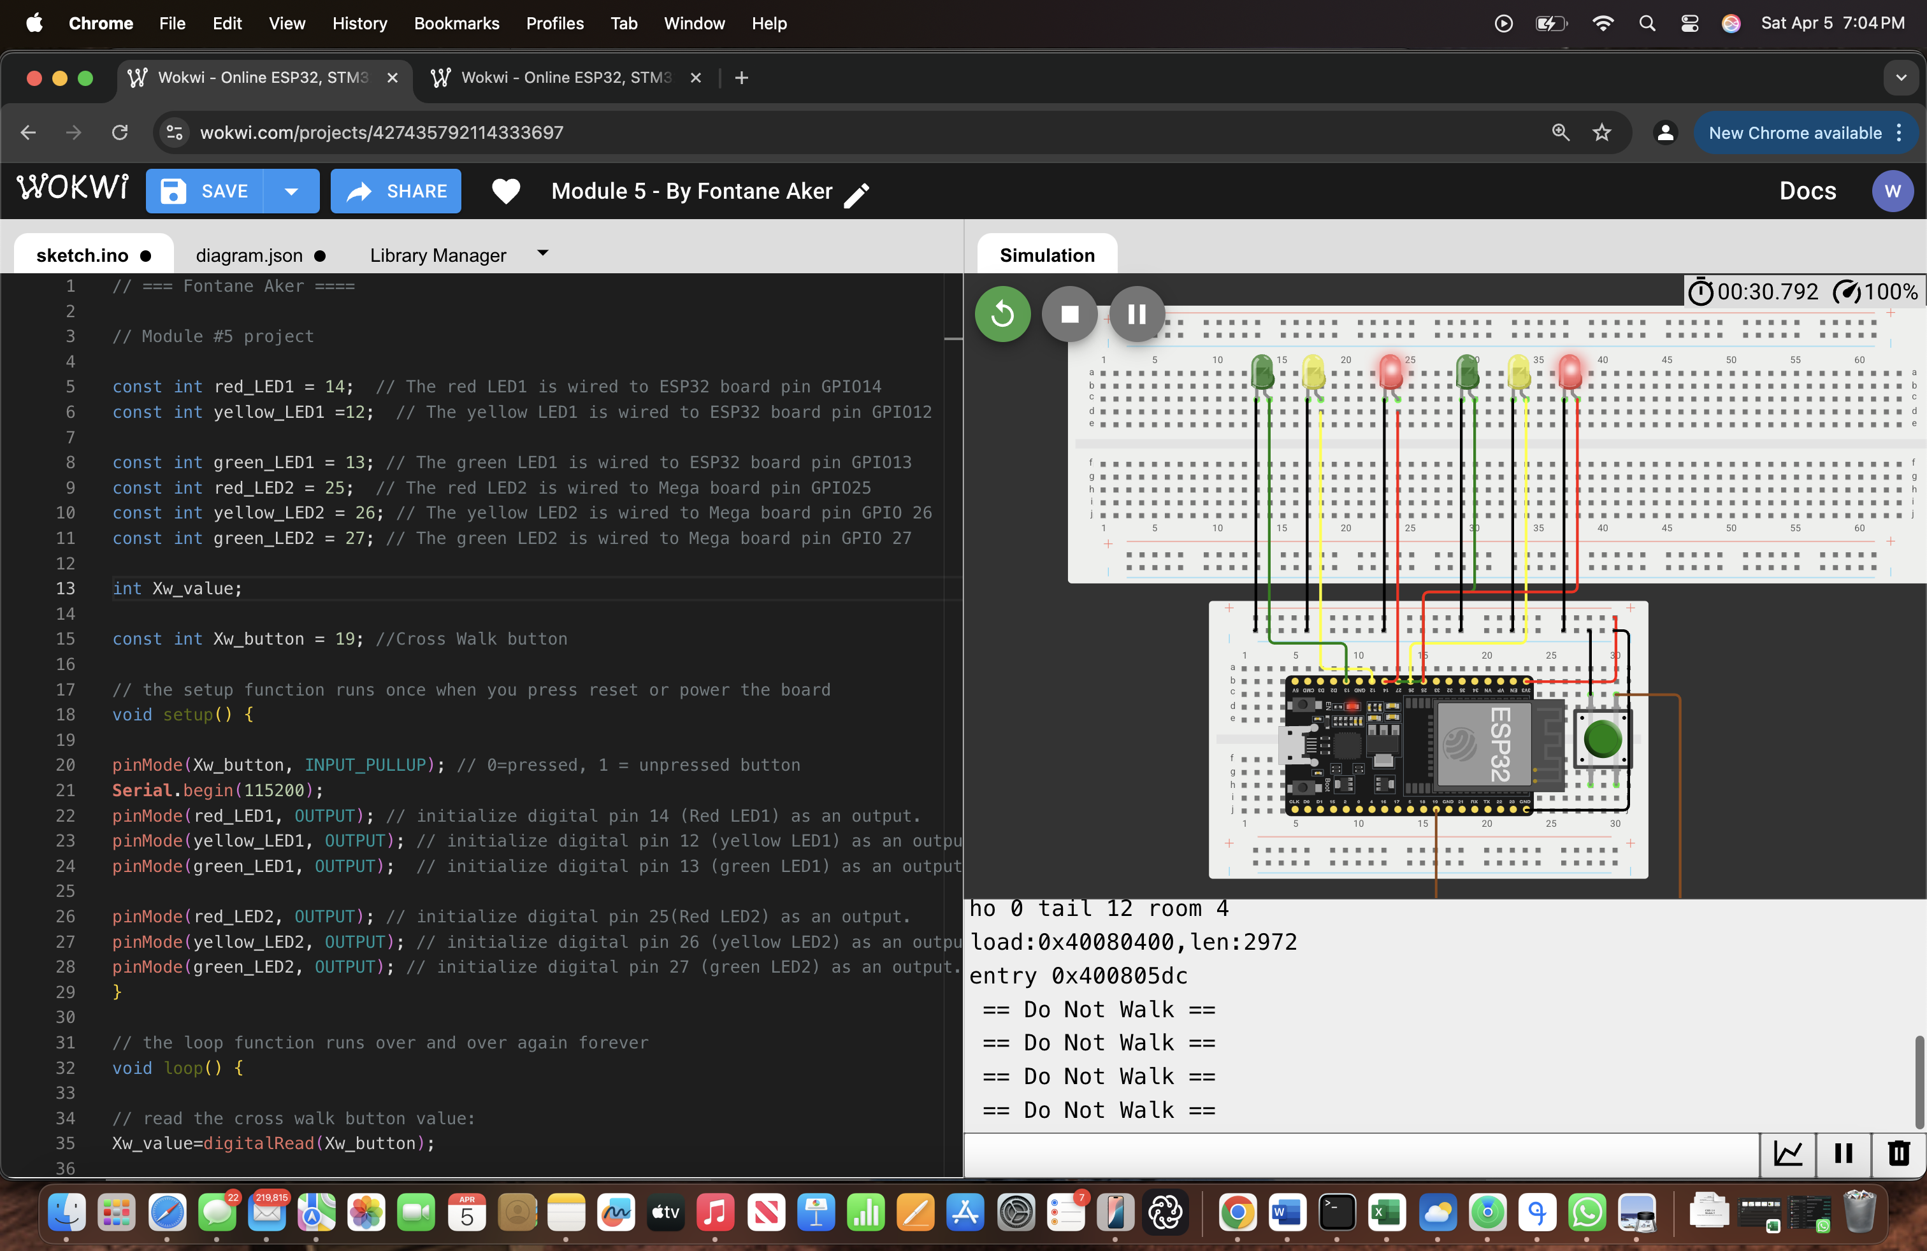
Screenshot of circuit with working LEDs
ESP 32 Board
Colored LEDs: Red, Yellow and Green (two sets)
220 Ohm Resistors (optional)
Push Button
Wires
Breadboard

Slide 11
Screenshot of code in Wokwi
Screenshot of code in Wokwi Code Editor showing your name in the comment

Slide 12
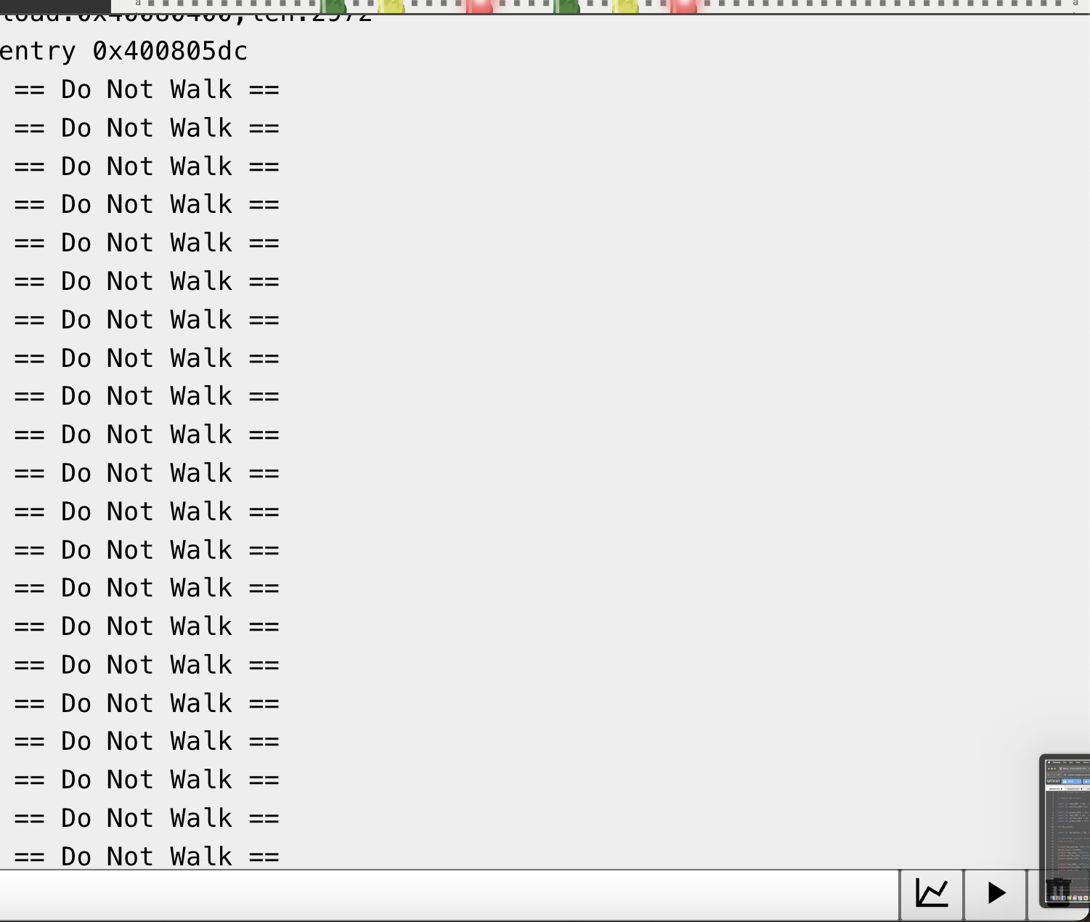
Screenshot of Serial Monitor in Wokwi
Screenshot of output in Serial Monitor

Slide 13
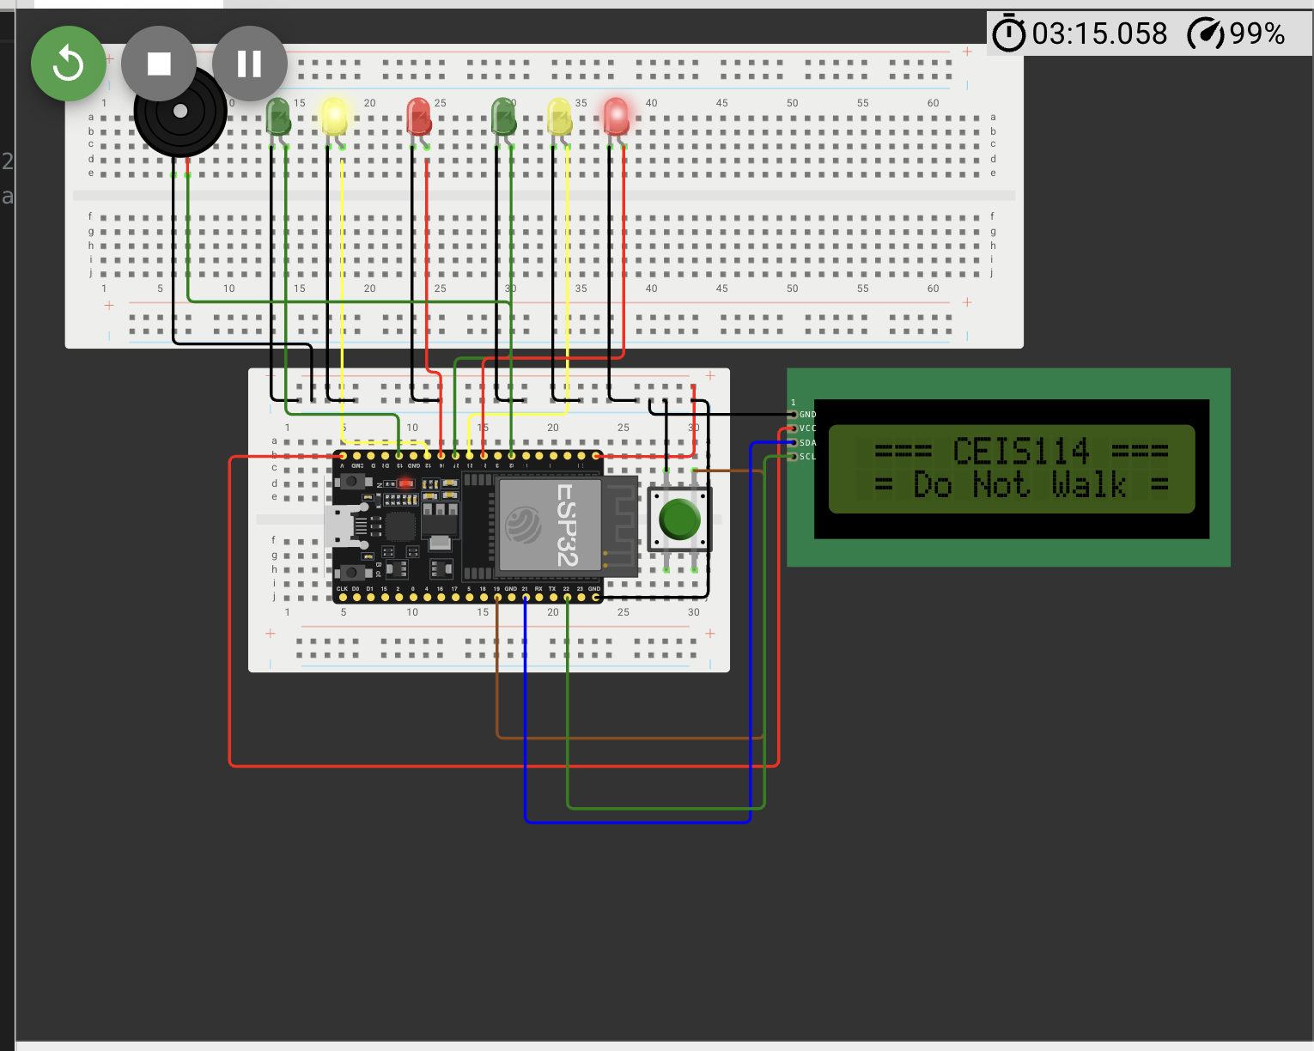
Picture of circuit with working LEDs and LCD display
ESP 32 Board
Colored LEDs: Red, Yellow and Green (two sets)
220 Ohm Resistors (optional)
Push Button
LCD Unit with Message Display
Wires
Breadboard

Slide 14
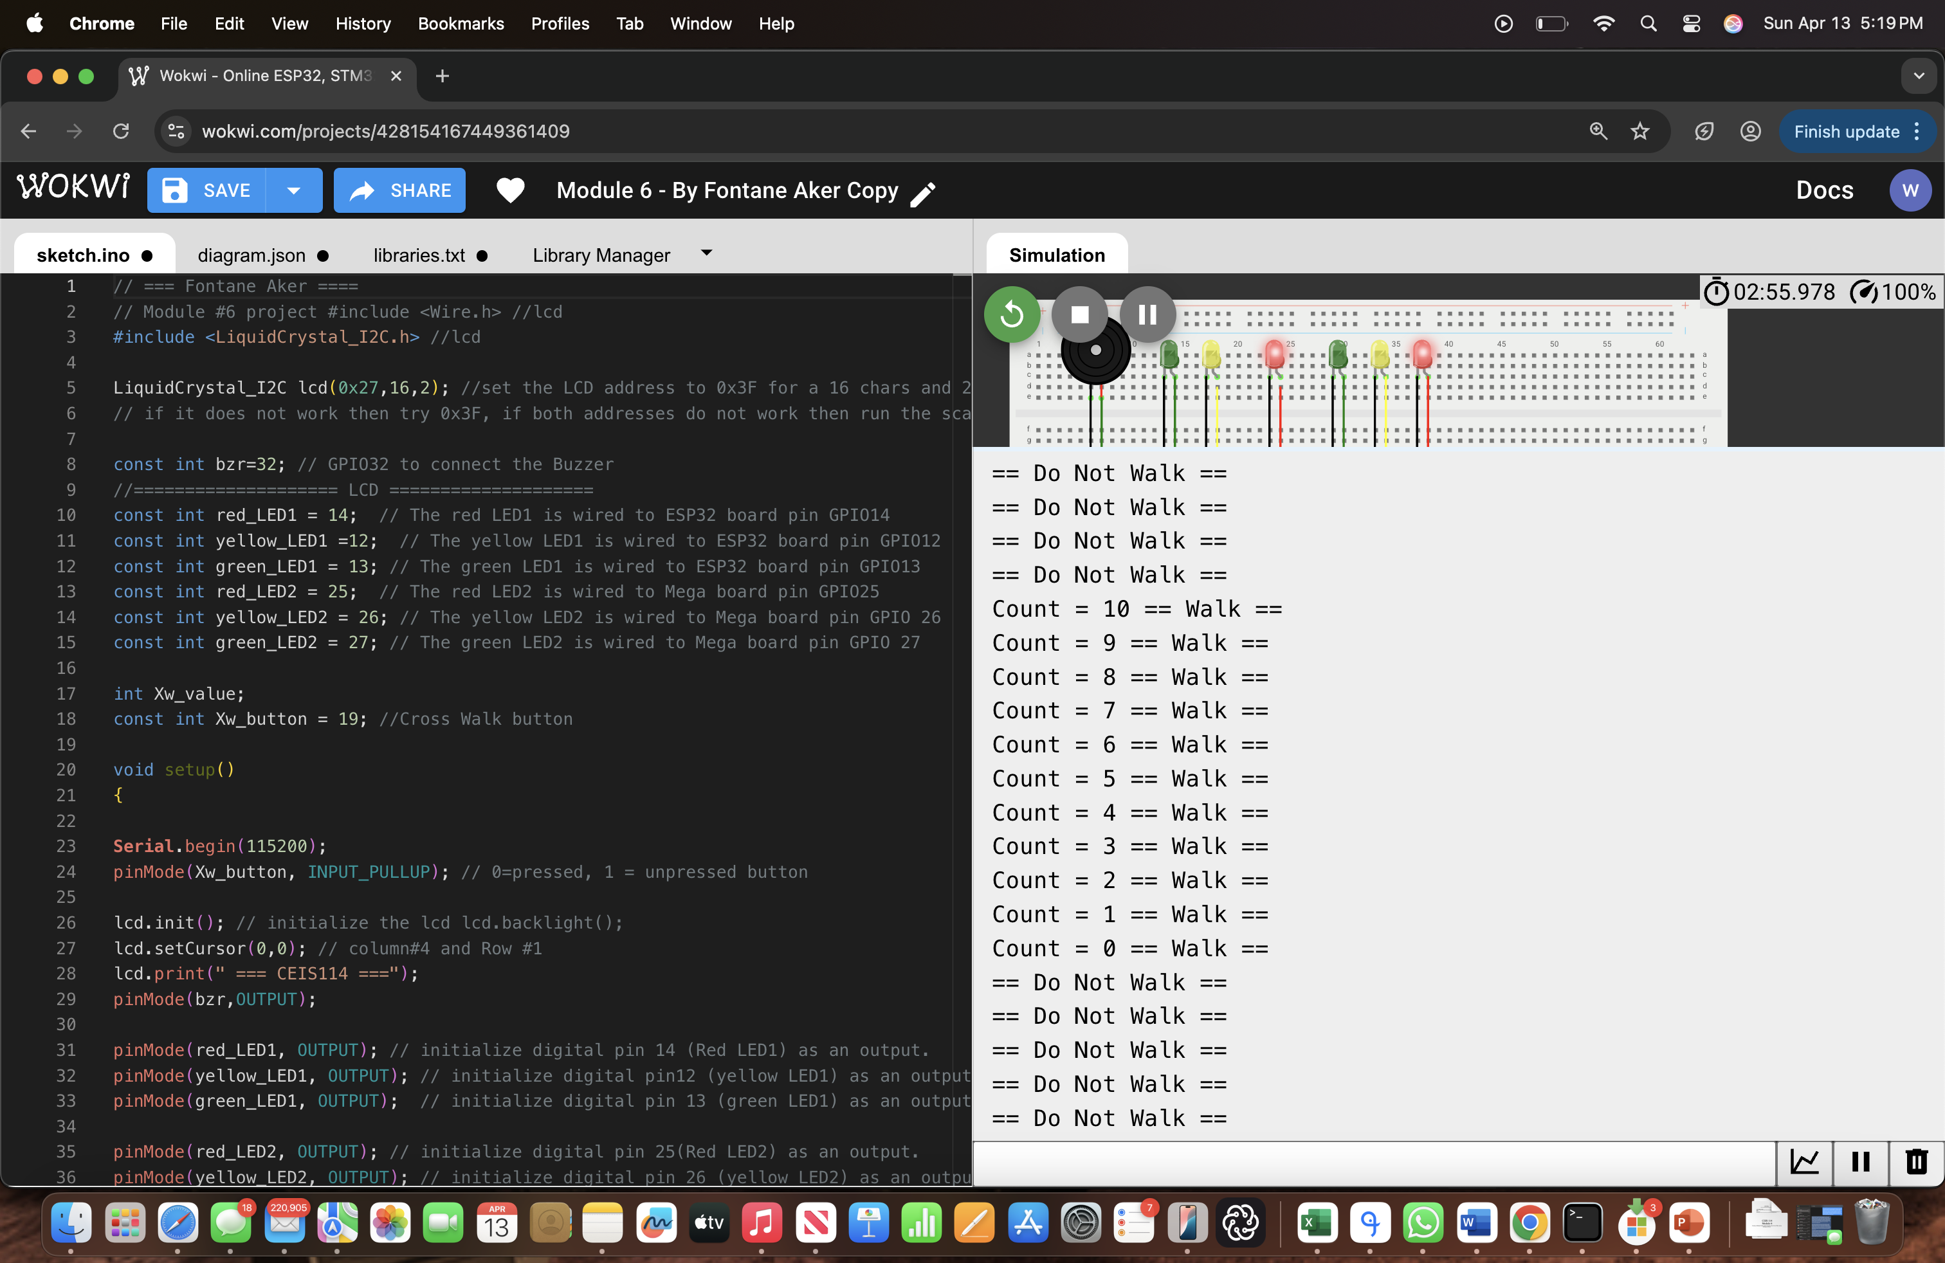
Screenshot of code in Code Editor
Screenshot of code in Code Editor showing your name in the comment

Slide 15
Screenshot of Serial Monitor
Screenshot of output in Serial Monitor

Slide 16
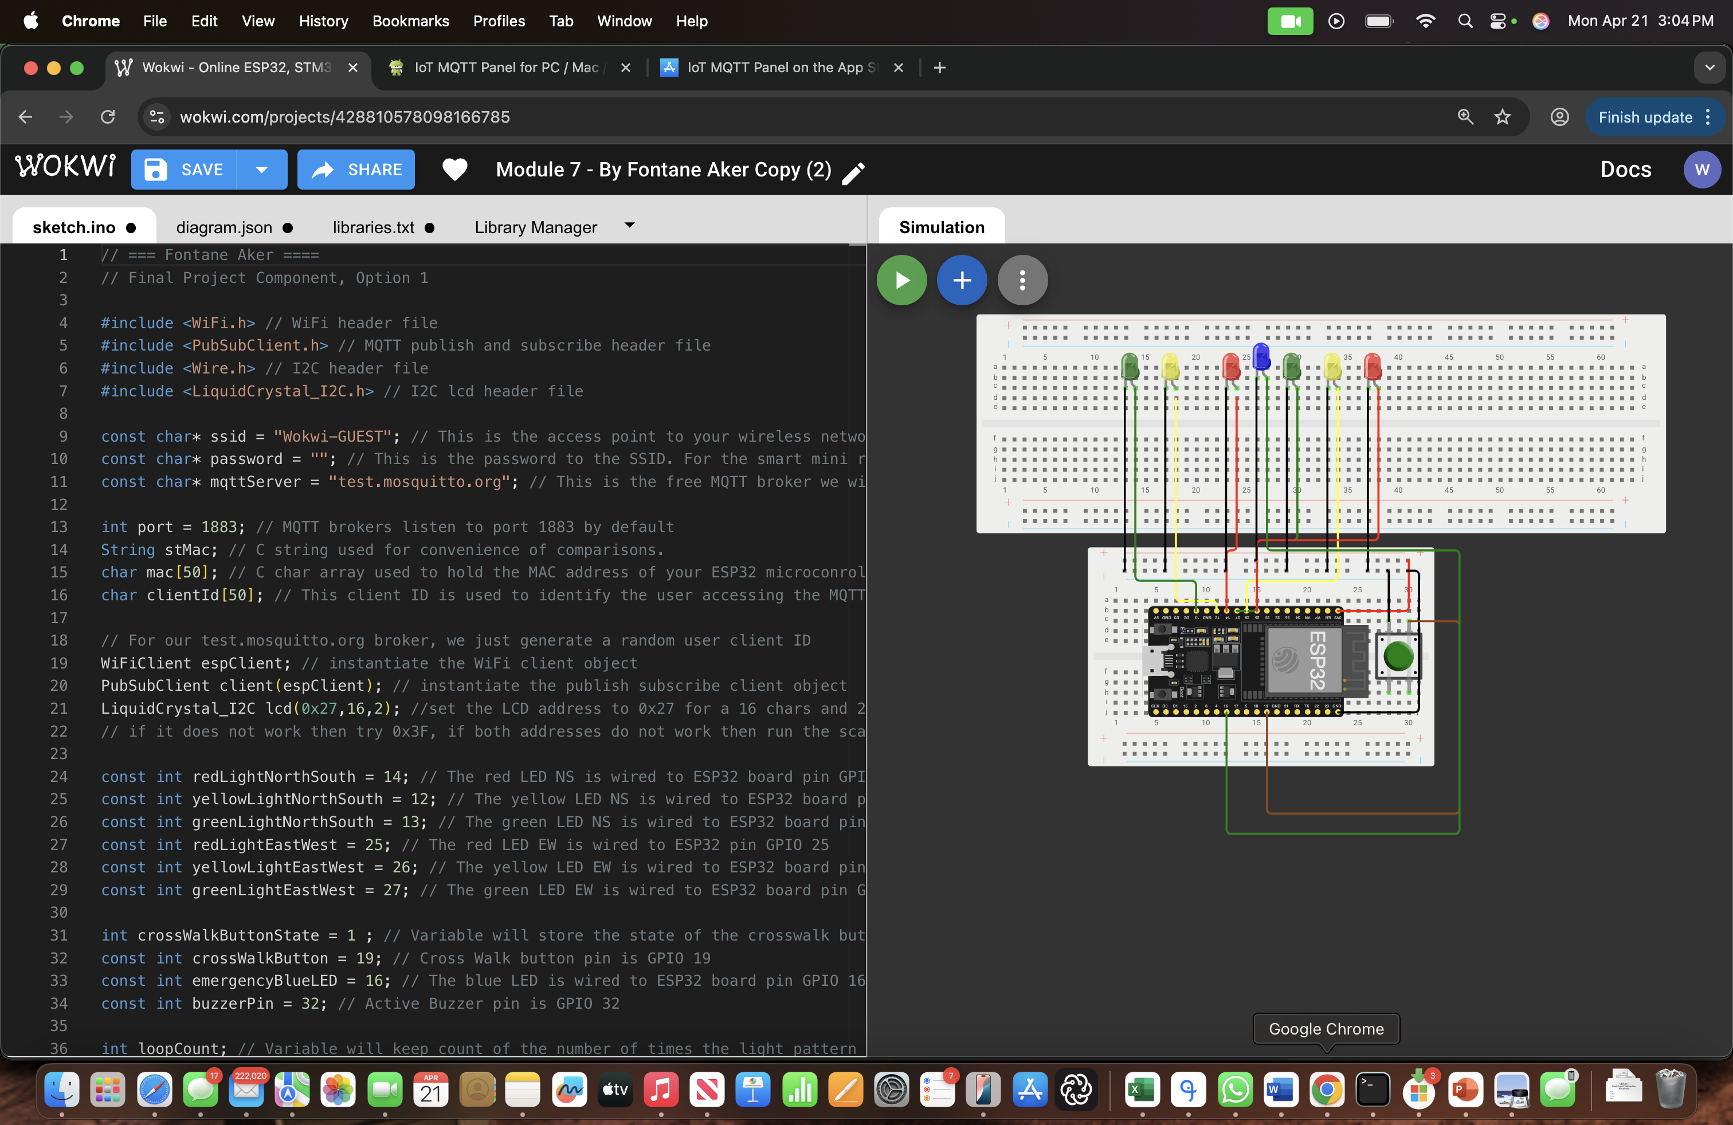
Screenshot of circuit with working LEDs and LCD display (Building/Operation)
ESP 32 Board
Colored LEDs: Red, Yellow and Green (two sets)
One Blue LED – Emergency Light
Push Button
LCD Unit
Buzzer
Wires
Breadboard

Slide 17
Screenshot of code in Code Editor (Testing)
Screenshot of code in Code Editor showing your name in the comment

Slide 18
Challenges
I really didn’t run into any challenges until the last project 7.
Which I think was a user error it was more of a website error.

Slide 19
Conclusion
In conclusion it helped me bring back the skills I learned in the first introduction to IOT class where we wired the Audino board for the home security.
This time was more specific with the wiring.

