Slide 1
Arduino project using Tinker Cad
CEIS101 Final Course Project
Fall session
Fontane Aker
Prof. Kevin Moore

Slide 2
Introduction
In this project I setup a smart home automated security system
The objective was to practice coding and setting up an automated security system digitally through Tinkercad.
Tools that were use was Power point, Excel, Microsoft Words, and Tinkercad.

Slide 3
CEIS101
Module 2
Circuit Simulation in Tinkercad
By : Fontane Aker

Slide 4
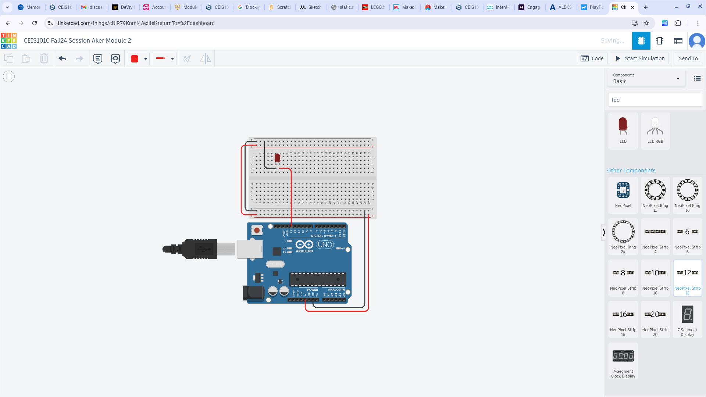
Circuit (Screenshot)

Slide 5
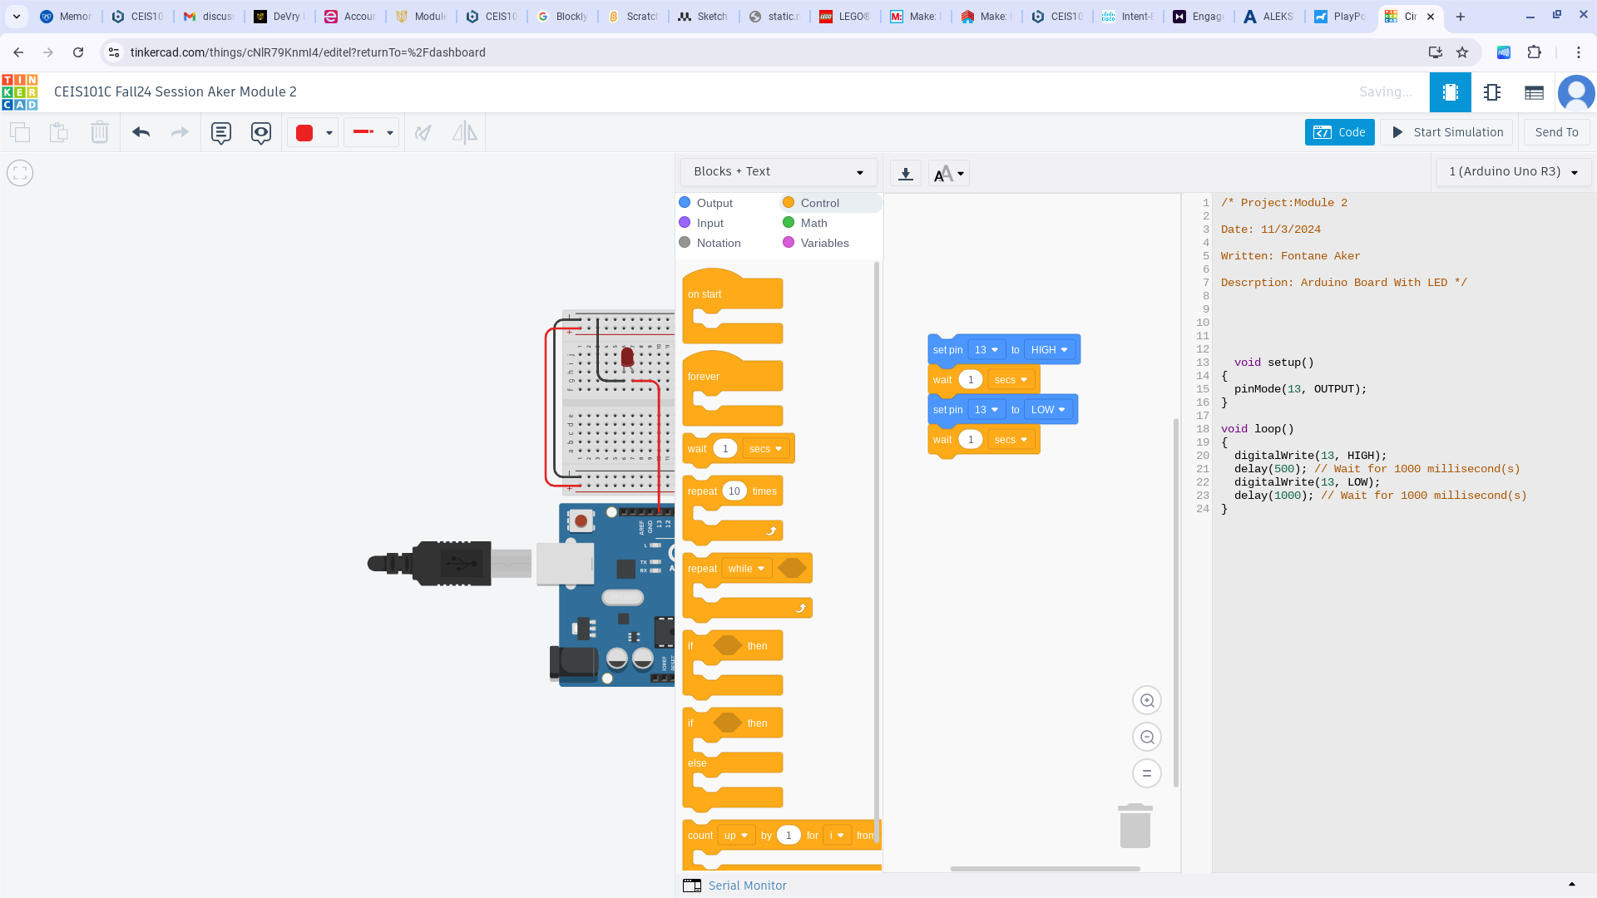
Code (Screenshot)

Slide 6
CEIS101
Module 3
Inventory of Parts, Circuit Building, and Displaying Messages
Fontane Aker

Slide 7
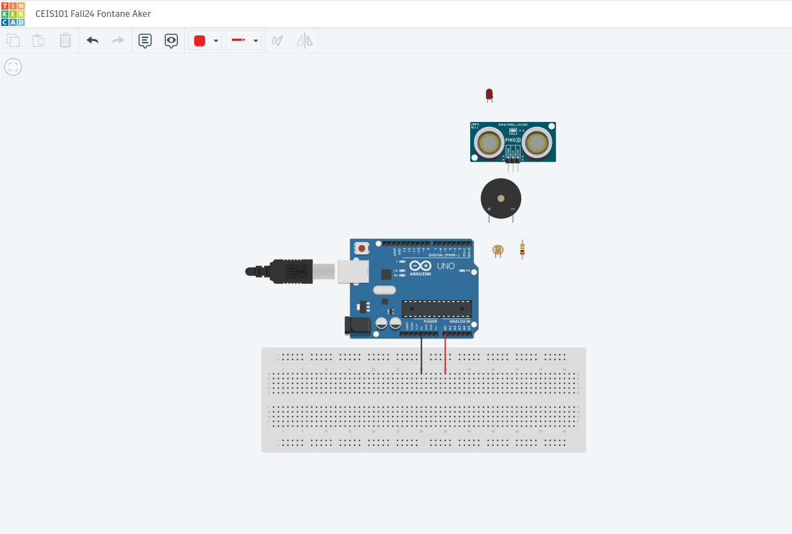
Organization of Project Components (picture)
Arduino Uno
Breadboard
Resistor 10kΩ
LEDs
Ultrasonic Sensor
Active Buzzer
Photoresistor
Wires

Slide 8
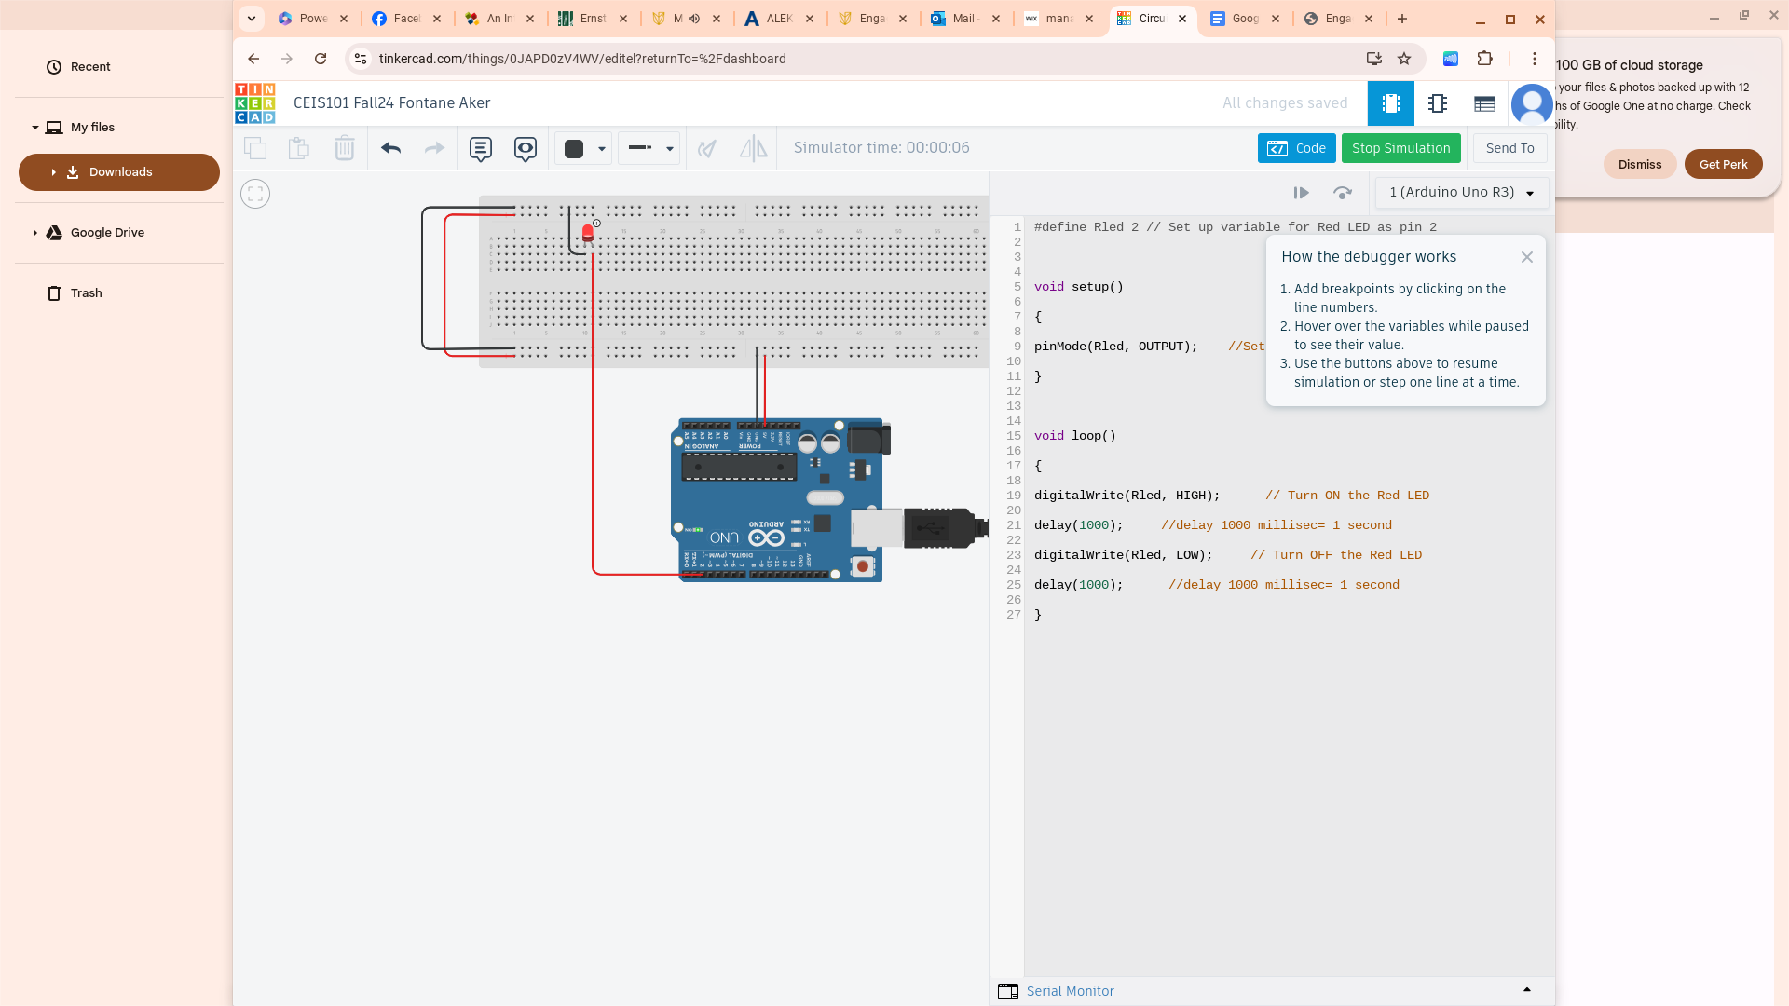
Circuit with red LED on (picture)

Slide 9
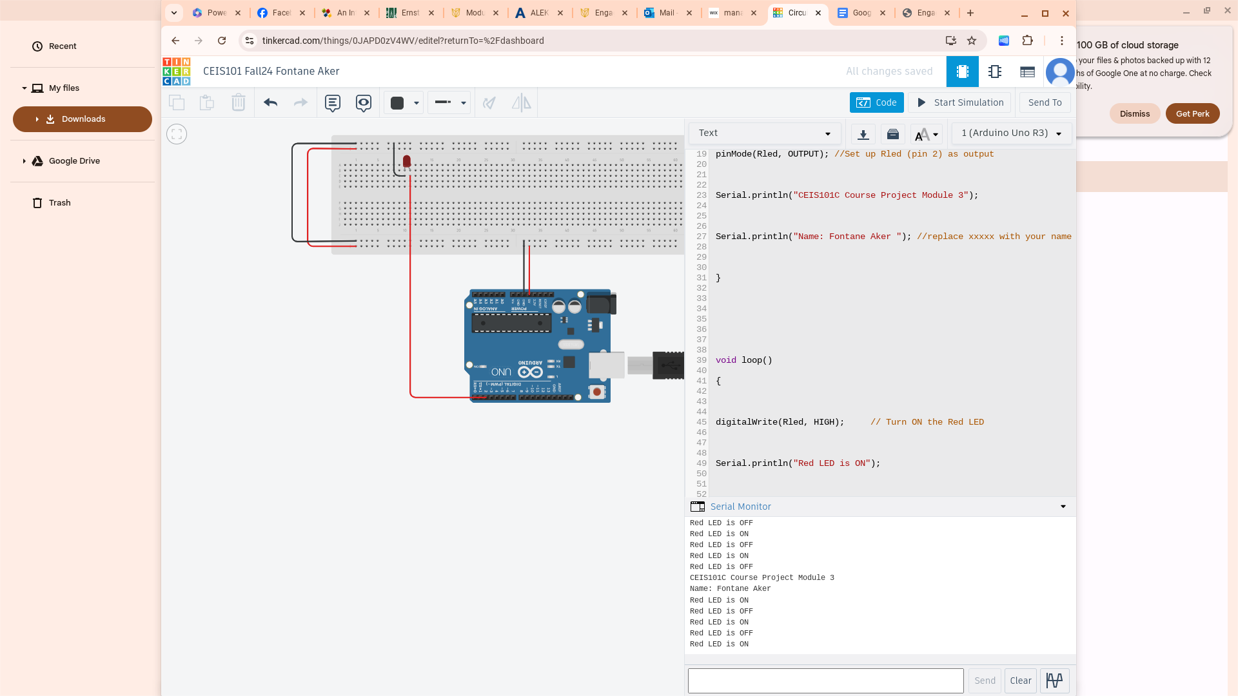
Serial Monitor (screenshot)

Slide 10
CEIS101
Module 4
Adding Door Sensor to Smart Home System
Fontane Aker

Slide 11
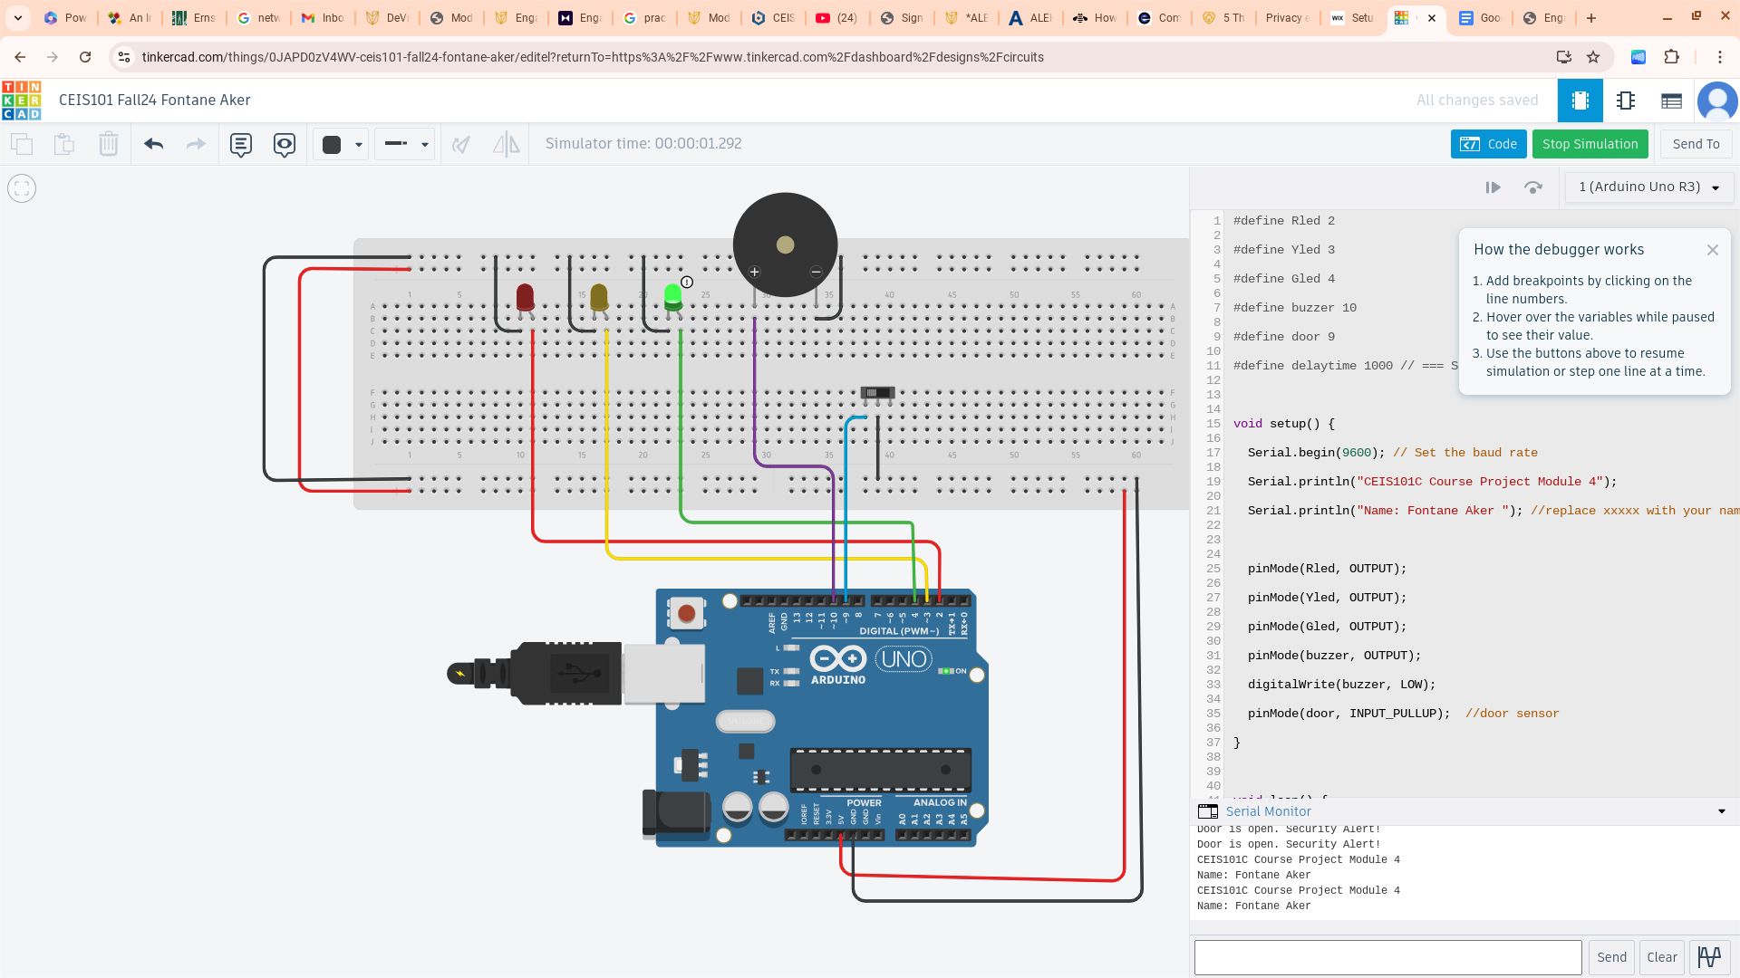
Circuit of door closed with Green LED ON (picture)

Slide 12
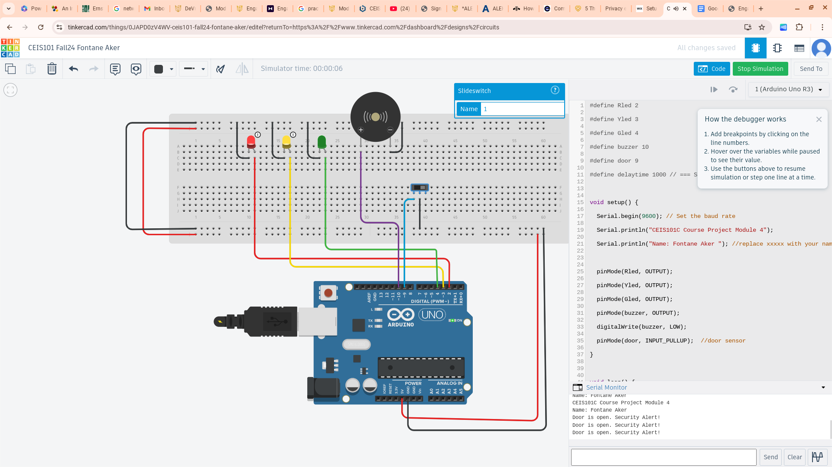
Circuit of door open with Green LED OFF (picture)

Slide 13
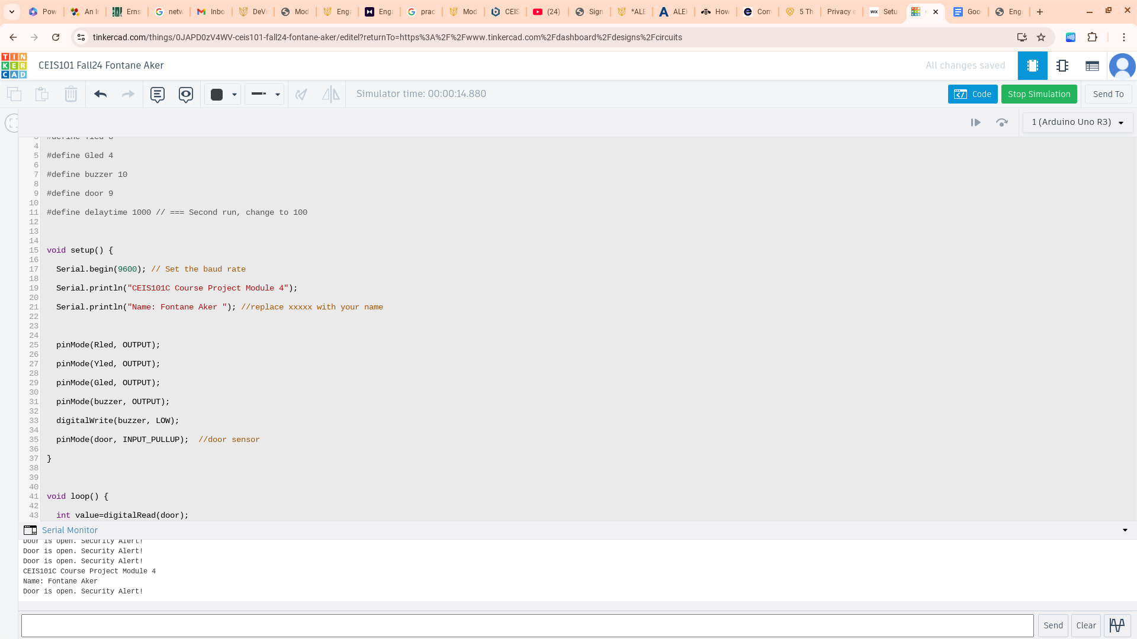
Arduino Code (screenshot)

Slide 14
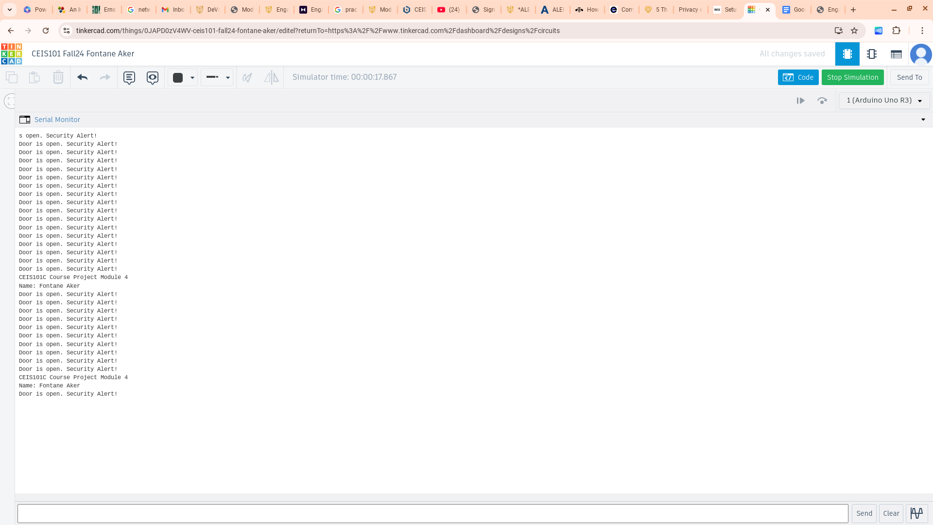
Serial Monitor (screenshot)

Slide 15
CEIS101
Module 5
Adding Distance Sensor to Smart Home System
and Conducting Data Analysis
Fontane Aker

Slide 16
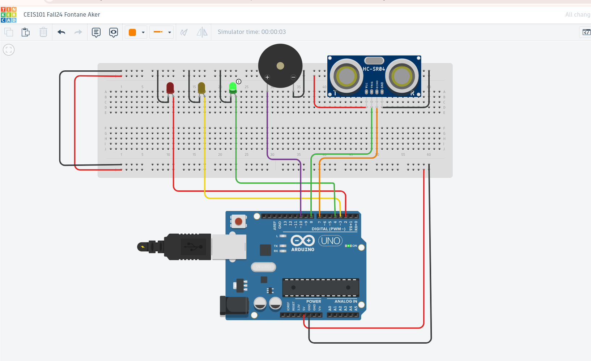
Circuit with green LED on (picture)

Slide 17
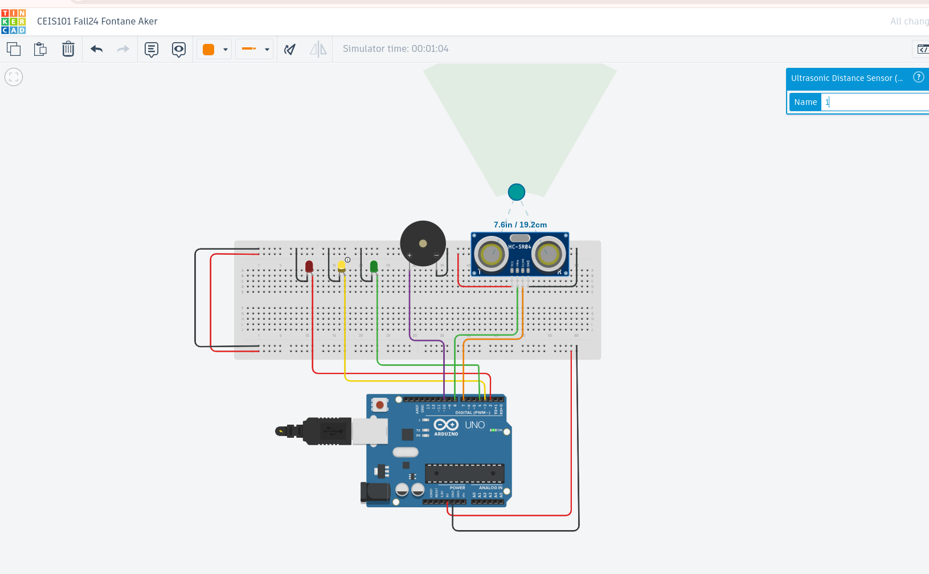
Circuit with yellow LED on (picture)

Slide 18

Circuit with red LED on (picture)

Slide 19
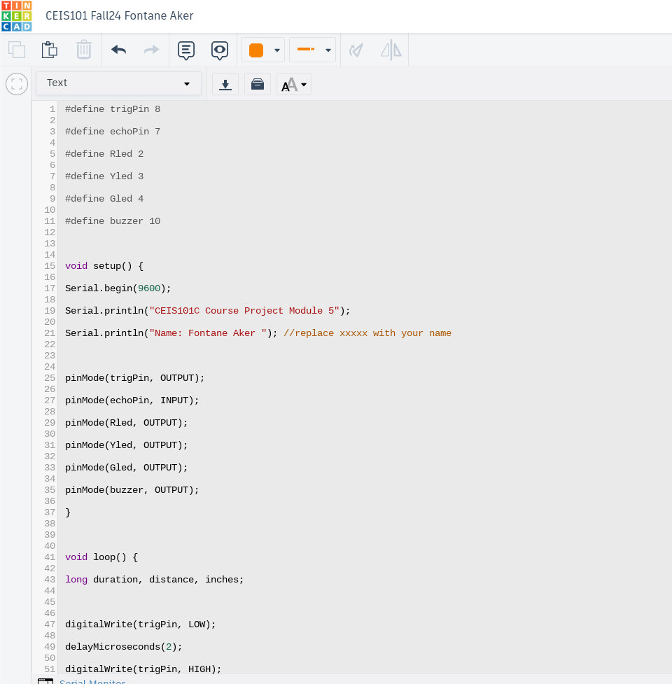
Arduino Code (screenshot)

Slide 20
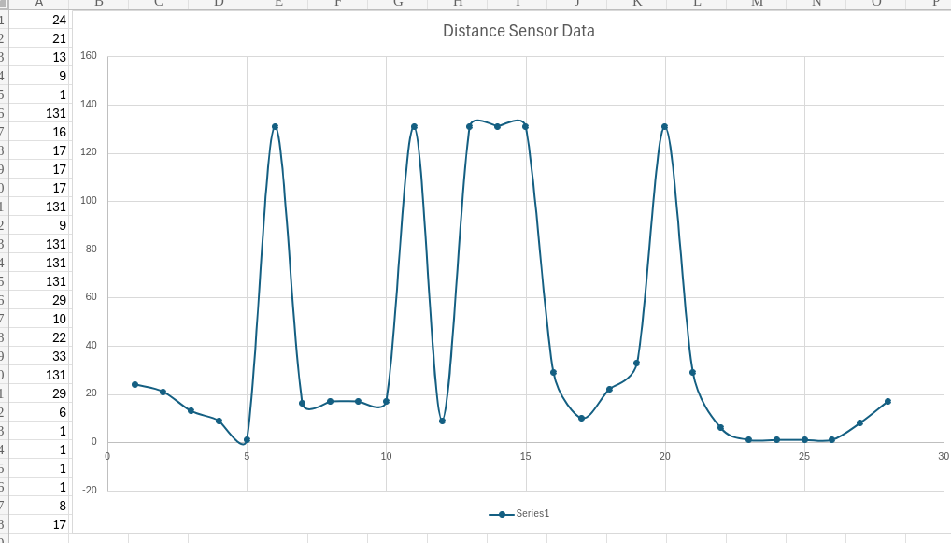
Plot of data (graph from Excel)

Slide 21
CEIS101
Module 6
Adding Automated Light to Smart Home System
Fontane Aker

Slide 22
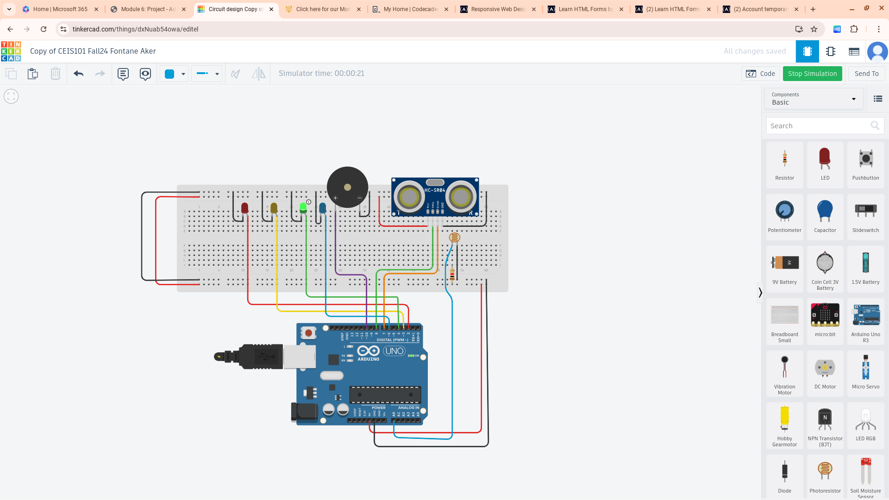
Circuit with automated LED off (picture)

Slide 23

Circuit with automated LED on (picture)

Slide 24
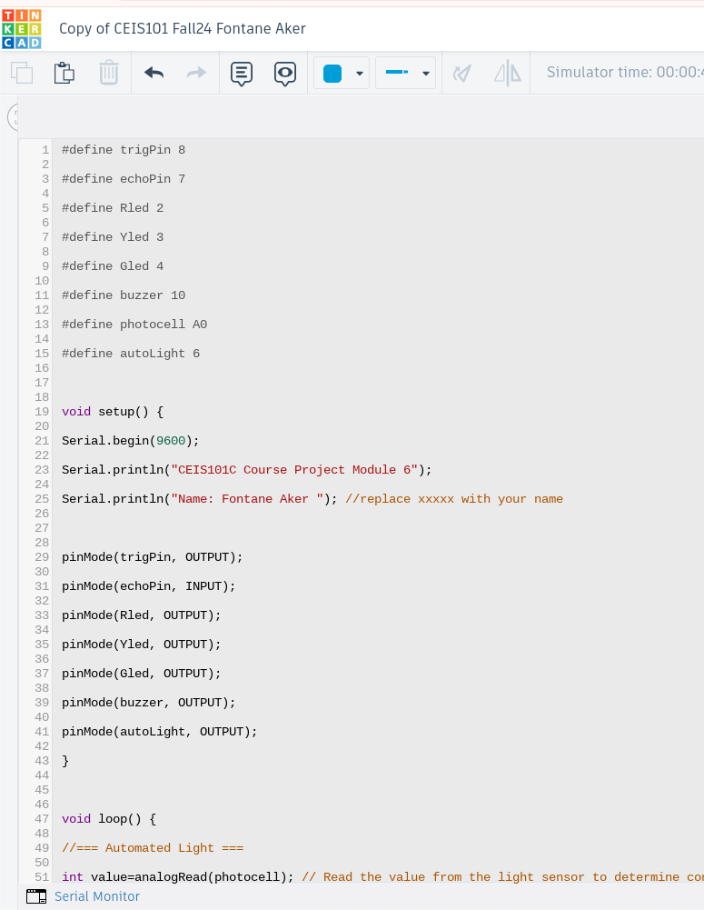
Arduino Code (screenshot)

Slide 25
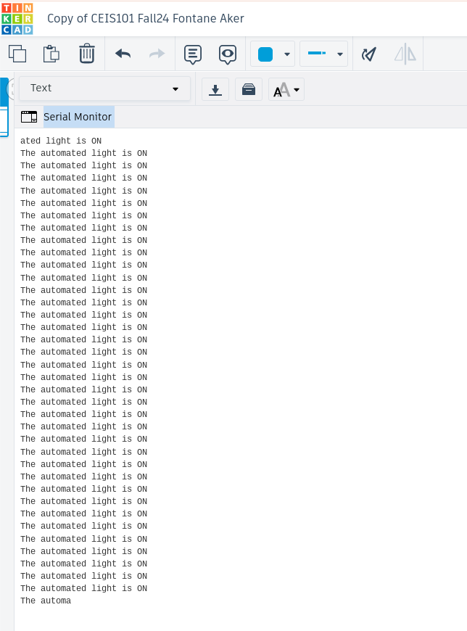
Serial Monitor (screenshot)

Slide 26
Challenges/Lessons Learned
Certain challenges I faced at first was understanding the coding process when it came to getting certain signals to activate.
I followed the instructions gave by the professor closely and everything came together.
In This project I learned how to properly wire the Arduino with the proper colors. Also, while correctly utilizing the positives and negatives slots. Giving all components their own pin slots so when coded it does what the code says.
I also learned what actions certain codes made the component work.

Slide 27
Career Skills
I developed hand on technical skills to start wiring and basic coding by manipulating certain outputs.
I think understanding what actions codes do and why will help me advance in my career.
Also, learning more about setting up physical components from the ground up and adding the necessary codes to make them work will be a good skill for the future.

Slide 28
Conclusion
In this project I learned many different skills when it comes to the Arduino board. I learned how properly wire the board. Making sure every component had their own colors and is wired neatly without crossing other wires. I also learn what to look for in certain codes to make components perform. Even though it's just the beginning I got a great understanding on what to expect throughout my education. Everything won't be all digital you have to have hands on technical skills to really understand the ins and out.

Slide 29
References
Most of my resources came from using Tinker Cad, and all the information given by my professors.
Outside of what I was given by my professors I took it upon myself to learn a little more about coding starting with html.

